Slide 1

Using Technology To Trigger Desired Consumer Behaviors & Responses.
(The 10 minutes version)
Smart Tech 2016 – 4/7/2016

Slide 2
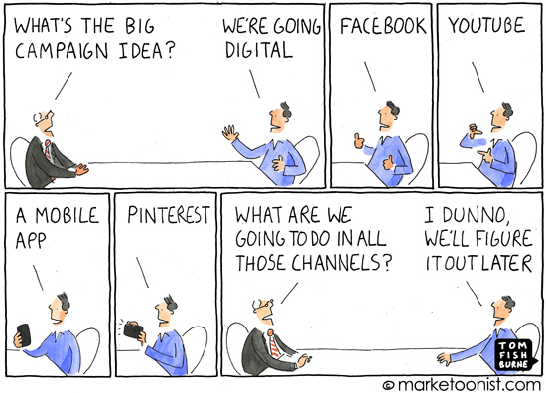
Your Brand Is An ECO-SYSTEM OF ACCESS POINTS, Not A Succession Of Media Channels
Each Touch Point Is An OPPORTUNITY TO CHANGE THE PLAYERS BEHAVIOR
Smart Phone
Website
Social Media
Players/
Non-Players
Ads
Loyalty Program
CRM
POS
Vending Machines
Notes:
Image you could increase conversion by 1%, everything else being equal. How much more revenue would you be able to generate?

Slide 3
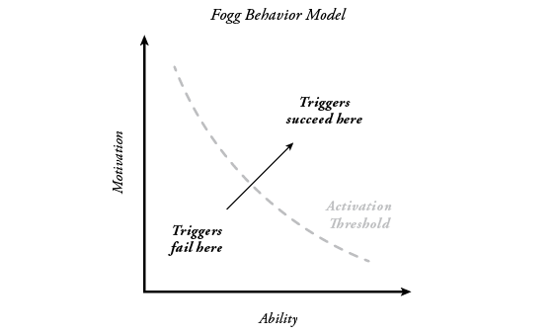
The BJ Fogg Model Of Behavioral Change (Stanford University).
A CHANGE IN BEHAVIOR REQUIRES:
The MOTIVATION to do so
(make it worthwhile)
The ABILITY to do so
(make it easy)
TRIGGERS
(to prompt the desired behavior)

Slide 4
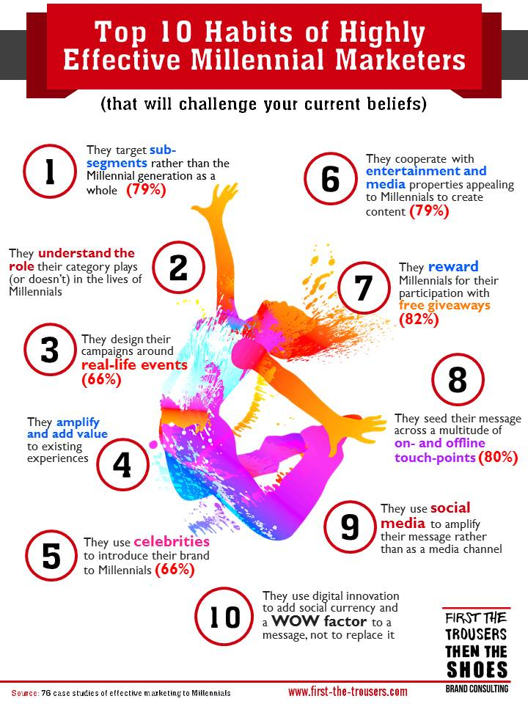

Motivation (Make It Worthwhile)
82% OF BRANDS
successful with Millennials encouraged their participation with FREE GIVEAWAYS

Slide 5


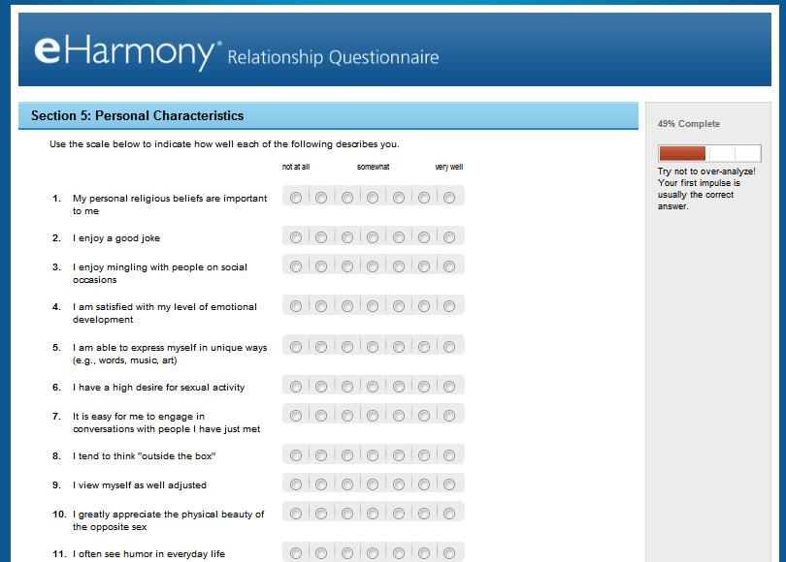
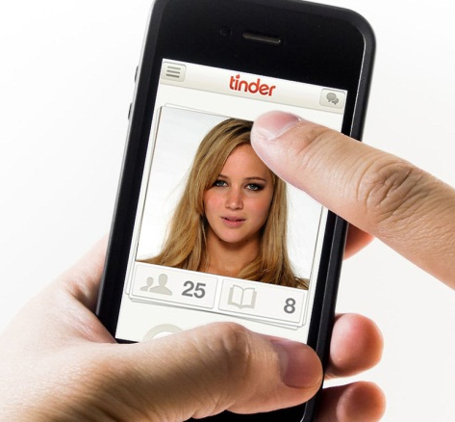
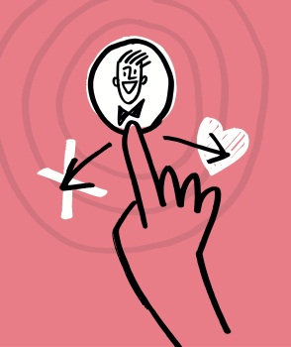
Ability (Make It Easy)
Vs.
800,000 USERS
50,000,000 USERS

Slide 6
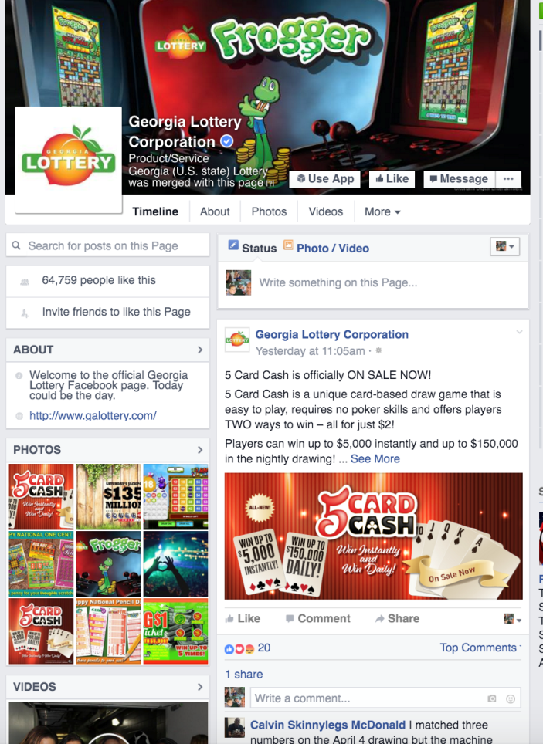
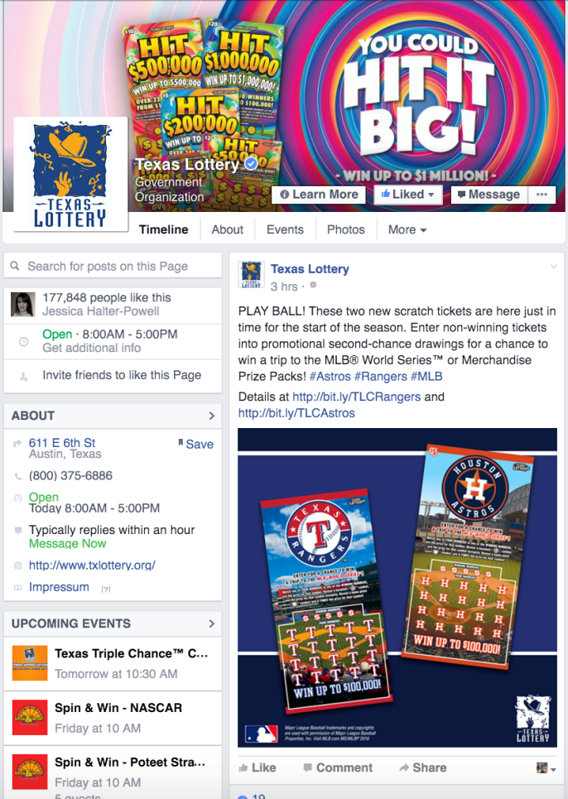
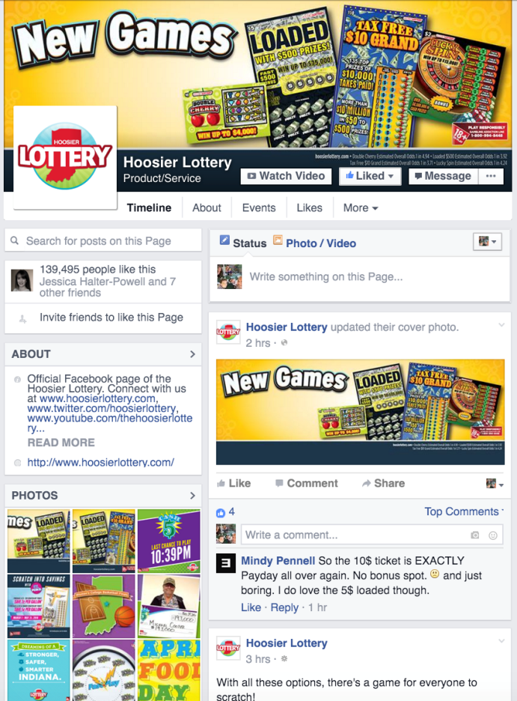
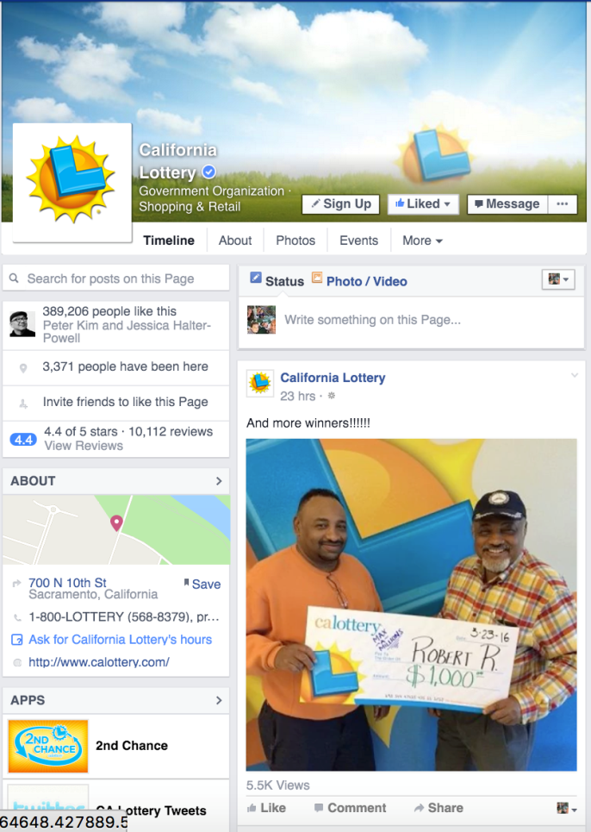
A Facebook Interaction Is An Opportunity To Change Consumers’ Behavior
(Download the APP? Sign-up for Loyalty Program? Etc.)
What behavior do you want to induce?
What would make it worth their while?
How can you make it easier for them?
What triggers will prompt the desired behavior?
Facebook?
Disclaimer: Any resemblance to existing Facebook pages is purely coincidental

Slide 7
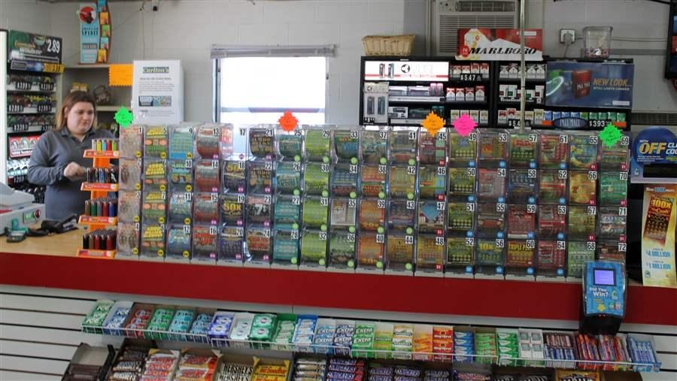
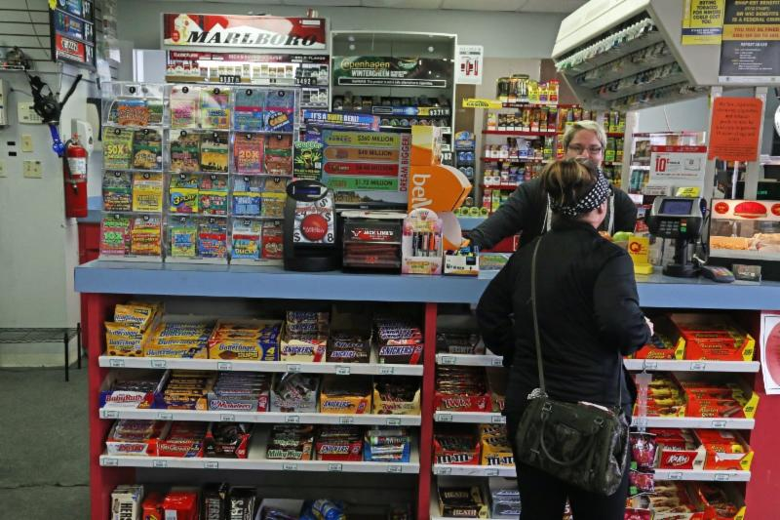
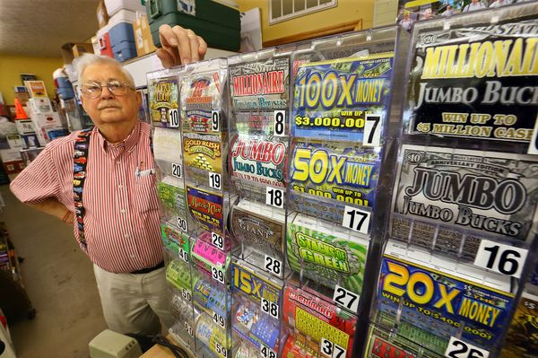

A Point-Of-Sale Visit Is An Opportunity To Change Consumers’ Behavior
(Trigger Purchase? Provide Guidance? Sign-up for Loyalty Program? Etc.)
What behavior do you want to induce?
What would make it worth their while?
How can you make it easier for them?
What triggers will prompt the desired behavior?
Point of Sale?
Notes:
The retail experience is intimidating, especially for non-players.

Slide 8
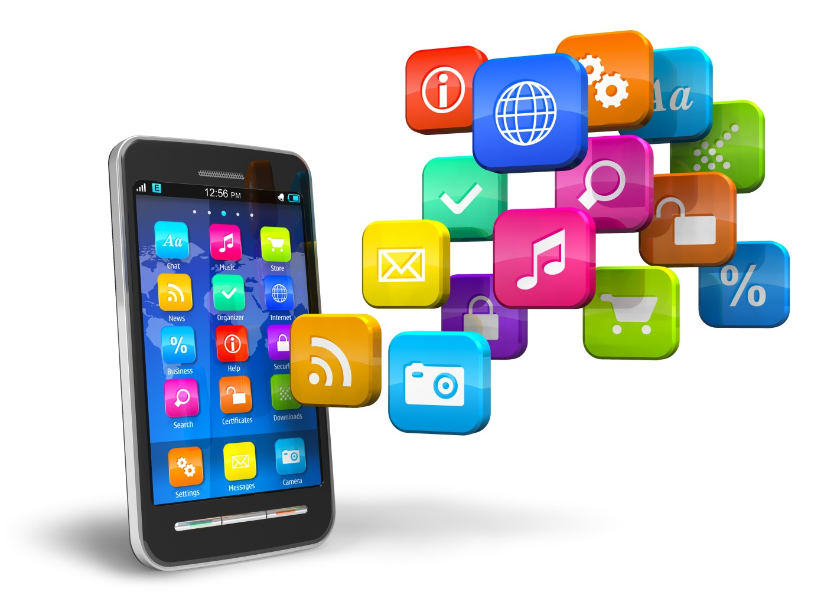
A Mobile App Is An Opportunity To Change Consumers’ Behavior
(Trigger Purchase? Repeat Purchase? Provide Guidance? Etc.)
What behavior do you want to induce?
What would make it worth their while?
How can you make it easier for them?
What triggers will prompt the desired behavior?
Notes:
The retail experience is intimidating, especially for non-players.

Slide 9
To Summarize
Smart Phone
1. Brand Touch Points Are ACCESS POINTS To A BRAND’S ECO-SYSTEM
2. Each Touch Point Is An Opportunity To CHANGE CONSUMERS BEHAVIORS (technology makes it easy)
3. To change a consumer behavior you need to PROVIDE:
2.1. The MOTIVATION, make it worth their while
2.2. The ABILITY, make it easy for them
2.3. TRIGGERS , to prompt the desired behavior
Website
Social Media
Players/
Non-Players
Ads
Loyalty Program
CRM
POS
Vending Machines

Slide 10
BRAND STRATEGY & INNOVATION
A SHORT INTRODUCTION

Slide 11
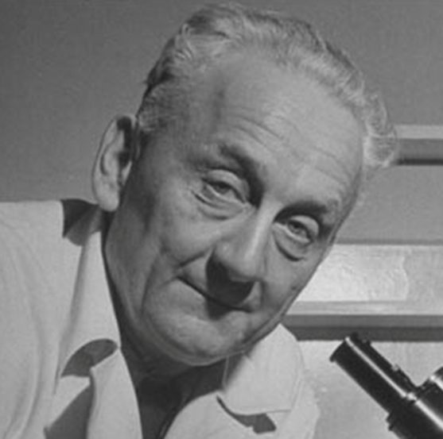
“
Discovery consists of seeing what everybody has seen and thinking what nobody has thought
Albert von Szent-Gyorgy
1937 Nobel Prize Winner, credited with discovering vitamin C

Slide 12
Who We Are
First The Trousers Then The Shoes Inc. (First The Trousers or FTT for short) is a brand strategy and innovation boutique dedicated to helping brands realize their business potential and grow.
Category Growth & Innovation
Brand Positioning & Storytelling
Consumer Insights
Communication strategies
Misc.
Identification of new
growth opportunities &
new product white spaces
Creation of compelling
positioning platforms and
brand stories
Identification and better
understanding of a brand’s
most promising consumer
segments
Development of
communication strategies
(briefs, customer journeys,
insights, etc.).
Process Optimization
Speeches,
Etc.

Slide 13
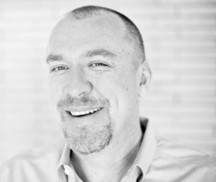
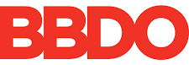













Ulli Appelbaum - Founder & Chief Strategy Officer
German-born, raised in Africa, Belgium and France, educated in France, England & Germany and currently living in the US (past 13 years). Speaks German, French and English.
20+ years of global experience building brands & developing new product concepts in Europe (West, Central & Eastern), Asia, Latin America and the US.
Prior to starting FTT, Ulli held various senior corporate positions including Global Planning Director at Fallon and BBDO Chicago respectively, Head of Account Planning at BBDO Germany and Leo Burnett Chicago and Director of Brand Strategy & Customer Experience at SapientNitro (LA & Minneapolis).
He has contributed to 7 Effie awards (for effective marketing) and an ARF Ogilvy award for Excellence in Research.
Client experience includes Nestle, Procter & Gamble, Unilever, United Healthcare, Bayer, Wrigley/Mars, Harley Davidson, Hallmark, Symantec, Chrysler, Siemens and many more.
Has helped Lottery agencies develop brand positioning platforms, multi-channel communication strategies, new product ideas and optimize their innovation and go-to-market process since 2011.
For more information contact Ulli Appelbaum at Ulli@first-the-trousers.com
www.First-The-Trousers.com
Languages
German, French and English
Experience
Clients

Slide 14





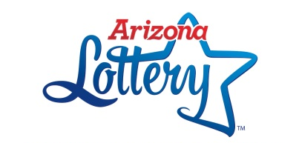


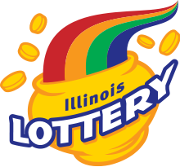



FIRST THE TROUSERS CLIENTS
(100% REFERRAL RATE, 81% REPEAT CLIENTS RATE*)
(* 81% of our clients are repeat clients. The remaining 19% are too small for a second assignment)

Slide 15
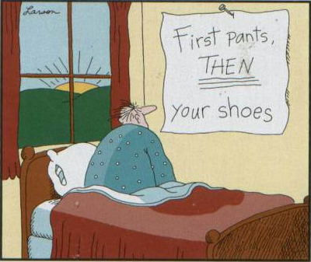
The First-The-Trousers Promise
Focus on strategy, not executions (Trousers first)
Rigorous and data driven in our approach, yet highly creative in our problem solving
We always provide a fresh perspective, we are contrarians
Our working style is very cooperative
We design solutions and assemble teams around our clients problems, not around our own needs or tools
We are nimble, with global reach
No buzz words, no attitude, no BS

